Slide 1
BLM2041 Signals and Systems
Syllabus
The Instructors:
Doç. Dr. Ali Can Karaca
ackaraca@yildiz.edu.tr
Dr. Öğr. Üyesi Erkan Uslu
euslu@yildiz.edu.tr
1
Notes:
1

Slide 2
DEFINITION(S) OF SYSTEM
A system can be broadly defined as an integrated set of elements that accomplish a defined objective.
People from different engineering disciplines have different perspectives of what a "system" is.
For example,
software ennngineers often refer to an integrated set of computer programs as a "system"
electrical engineers might refer to complex integrated circuits or an integrated set of electrical units as a "system"
As can be seen, "system" depends on one’s perspective, and the “integrated set of elements that accomplish a defined objective” is an appropriate definition.
2
Notes:
Bir sistem, genel olarak tanımlanmış bir amacı gerçekleştiren entegre bir öğeler kümesi olarak tanımlanabilir.
Farklı mühendislik disiplinlerinden insanlar sistemin ne olduğuyla ilgili farklı perspektiflere sahiptir.
Örn…
Sistem tanımı kişinin perspektifine bağlıdır. Tanım bunu içermektedir.
2

Slide 3
Information Systems:
Fundamentals
3

Slide 4
Definition(s) of system
A system is an assembly of parts where:
The parts or components are connected together in an organized way.
The parts or components are affected by being in the system (and are changed by leaving it).
The assembly does something.
The assembly has been identified by a person as being of special interest.
Any arrangement which involves the handling, processing or manipulation of resources of whatever type can be represented as a system.
Some definitions on online dictionaries
http://en.wikipedia.org/wiki/System
http://dictionary.reference.com/browse/systems
http://www.businessdictionary.com/definition/system.html
4
Notes:
Bir sistem, aşağıdakileri içeren bir parça grubudur:
The assembly -> birleştirmek
Hangi türde olursa olsun kaynakların işlenmesini, işlenmesini veya manipülasyonunu içeren herhangi bir düzenleme bir sistem olarak temsil edilebilir.
4

Slide 5
Definition(s) of system
A system is defined as multiple parts working together for a common purpose or goal.
Systems can be large and complex
such as the air traffic control system or our global telecommunication network.
Small devices can also be considered as systems
such as a pocket calculator, alarm clock, or 10-speed bicycle.
5
Notes:
Bir sistem, ortak amacı veya hedefi gerçekleştirmek için birlikte çalışan çoklu bileşenler olarak tanımlanabilir.
Embedded systems -> 4. sınıfta
5

Slide 6
Definition(s) of system
Systems have inputs, processes, and outputs.
When feedback (direct or indirect) is involved, that component is also important to the operation of the system.
To explain all this, systems are usually explained using a model.
A model helps to illustrate the major elements and their relationship, as illustrated in the next slide
6
Notes:
Sistemlerin girdileri, çıkışları ve giriş çıkış arasında işlemlere sahiptir.
Geri besleme de herhangi bir sistemin çalışıp çalışmadığını göstermek için önemli olmaktadır.
Tüm bunları anlatmak için sistemleri genellikle bir model üzerinden açıklarlar.
Bir model ana elemanları ve bunların birbiriyle ilişkisini göstermek için kullanılmaktadır.
6

Slide 7
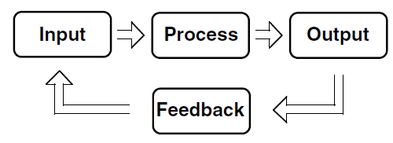
A systems model
7

Slide 8
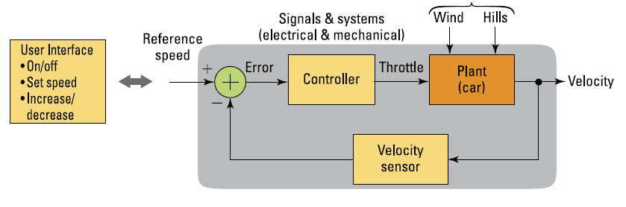
Arabalardaki Hız Sabitleme Sistemi
Giriş işareti: Referans hız, rüzgar ve yokuş olma durumu
Çıkış işareti: Arabanın hızı
Sistem
Ref: Signals and Systems for Dummies

Slide 9
Digital System
Takes a set of discrete information (inputs) and discrete internal information (system state) and generates a set of discrete information (outputs).
Discrete
Discrete
Inputs
Information
Discrete
Processing
Outputs
System
System State
9

Slide 10
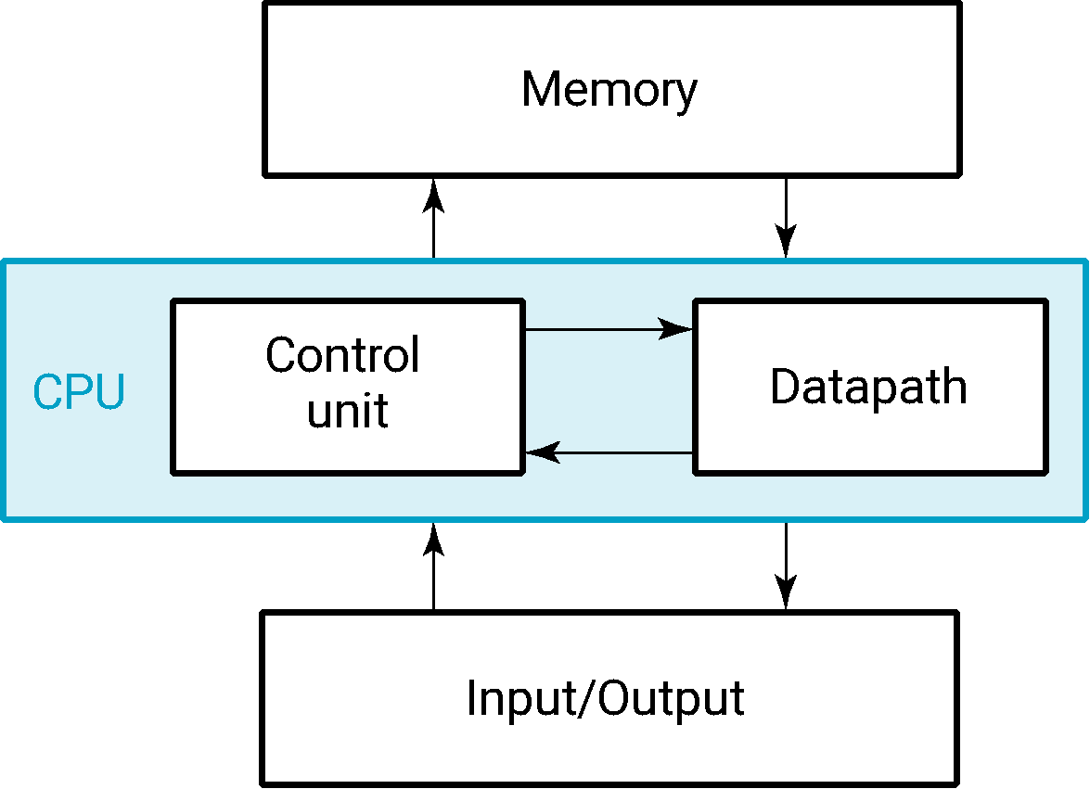
A Digital Computer Example
Inputs: Keyboard, mouse, modem, microphone
Outputs: CRT, LCD, modem, speakers
Synchronous or Asynchronous?
10
Notes:
Copyright 2000 N. AYDIN. All rights reserved.
10
Answer: Part of specification for a PC is in MHz.
What does that imply? A clock which defines the discrete times for update of state for a synchronous system. Not all of the computer may be synchronous, however.

Slide 11
Signal
An information variable represented by physical quantity.
For digital systems, the variable takes on discrete values.
Two level, or binary values are the most prevalent values in digital systems.
Binary values are represented abstractly by:
digits 0 and 1
words (symbols) False (F) and True (T)
words (symbols) Low (L) and High (H)
and words On and Off.
Binary values are represented by values or ranges of values of physical quantities
11

Slide 12
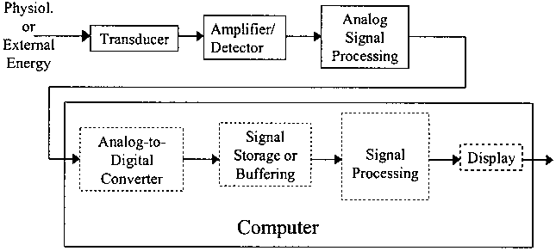
A typical measurement system
12
Notes:
Transducer -> güç dönüştürücü
12

Slide 13
Transducers
A “transducer” is a device that converts energy from one form to another.
In signal processing applications, the purpose of energy conversion is to transfer information, not to transform energy.
In physiological measurement systems, transducers may be
input transducers (or sensors)
they convert a non-electrical energy into an electrical signal.
for example, a microphone.
output transducers (or actuators)
they convert an electrical signal into a non-electrical energy.
For example, a speaker.
13

Slide 14
Analogue signal
The analogue signal
a continuous variable defined with infinite precision
is converted to a discrete sequence of measured values which are represented digitally
Information is lost in converting from analogue to digital, due to:
inaccuracies in the measurement
uncertainty in timing
limits on the duration of the measurement
These effects are called quantisation errors
14

Slide 15
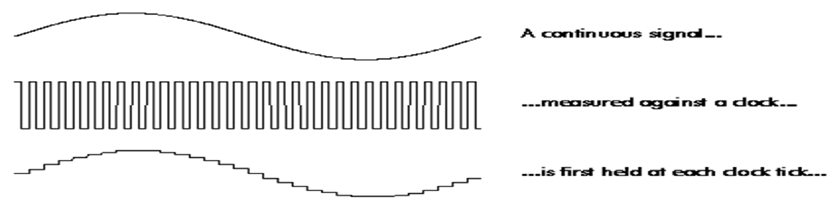



Digital signal
The continuous analogue signal has to be held before it can be sampled
Otherwise, the signal would be changing during the measurement
Only after it has been held can the signal be measured, and the measurement converted to a digital value
15

Slide 16
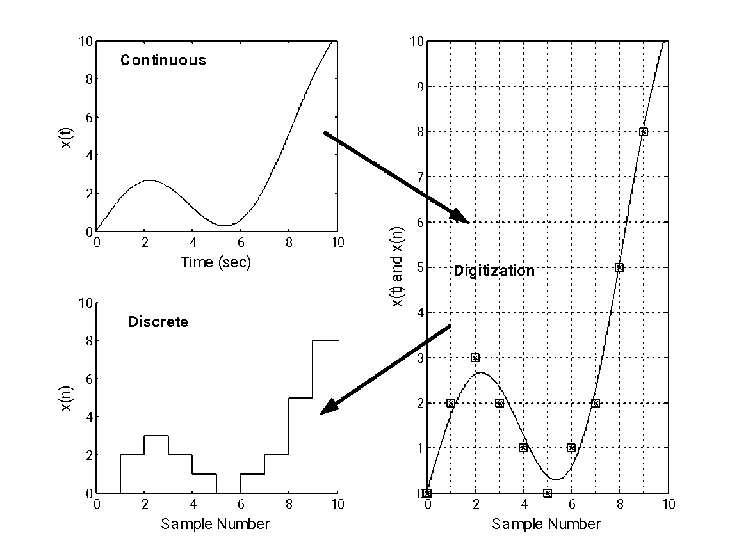
Signal Encoding: Analog-to Digital Conversion
Continuous (analog) signal ↔ Discrete signal x(t) = f(t) ↔ Analog to digital conversion ↔ x[n] = x [1], x [2], x [3], ... x[n]
16

Slide 17




Analog-to Digital Conversion
ADC consists of four steps to digitize an analog signal:
Filtering
Sampling
Quantization
Binary encoding
Before we sample, we have to filter the signal to limit the maximum frequency of the signal as it affects the sampling rate.
Filtering should ensure that we do not distort the signal, ie remove high frequency components that affect the signal shape.
17
Notes:
Örtüşme sadece ses gibi tek boyutlu sinyallerde değil, kamera veya bizim görme sistemlerimizde de oluşmaktadır.
Helikopterin pervanesi kamera ile aynı frekansta pozlarsa:
https://www.youtube.com/watch?v=R-IVw8OKjvQ
Araçların tekerleklerinin geriye doğru dönüyor gibi görünmesi
Stroboskobik etki
17

Slide 18
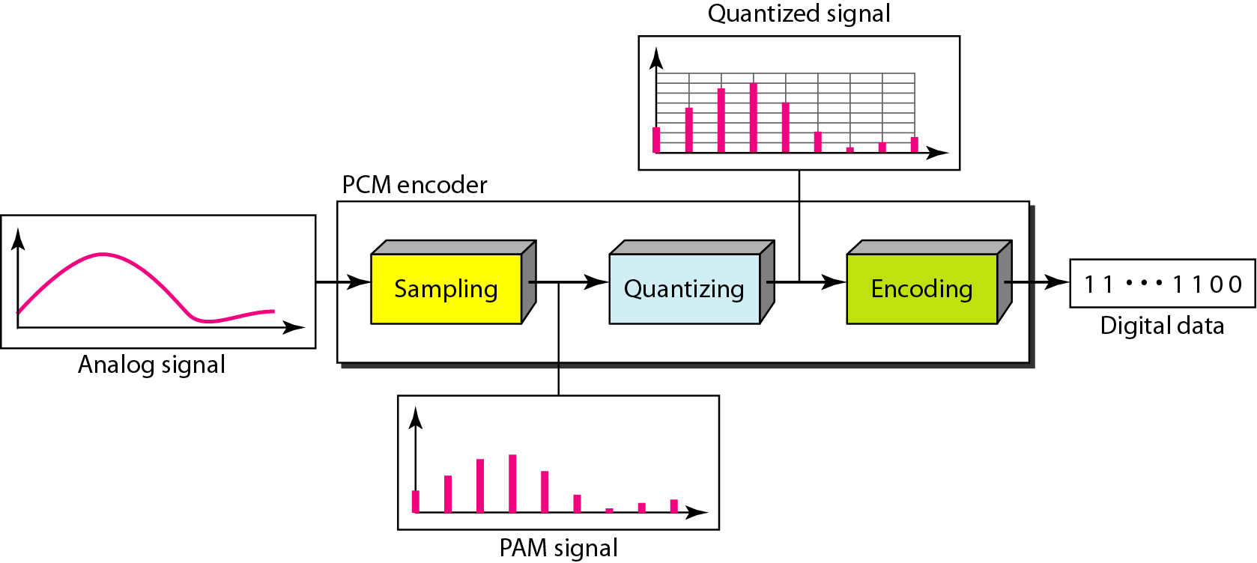
18
Notes:
18

Slide 19
Sampling
The sampling results in a discrete set of digital numbers that represent measurements of the signal
usually taken at equal intervals of time
Sampling takes place after the hold
The hold circuit must be fast enough that the signal is not changing during the time the circuit is acquiring the signal value
We don't know what we don't measure
In the process of measuring the signal, some information is lost
19

Slide 20


Sampling
Analog signal is sampled every T_{S} secs.
T_{s} is referred to as the sampling interval.
f_{s} = 1/T_{s} is called the sampling rate or sampling frequency.
There are 3 sampling methods:
Ideal - an impulse at each sampling instant
Natural - a pulse of short width with varying amplitude
Flattop - sample and hold, like natural but with single amplitude value
The process is referred to as pulse amplitude modulation PAM and the outcome is a signal with analog (non integer) values
20

Slide 21
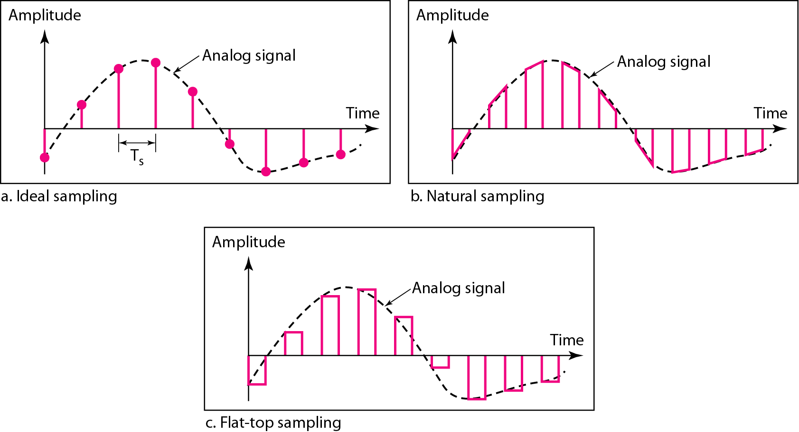



21
Notes:
21

Slide 22
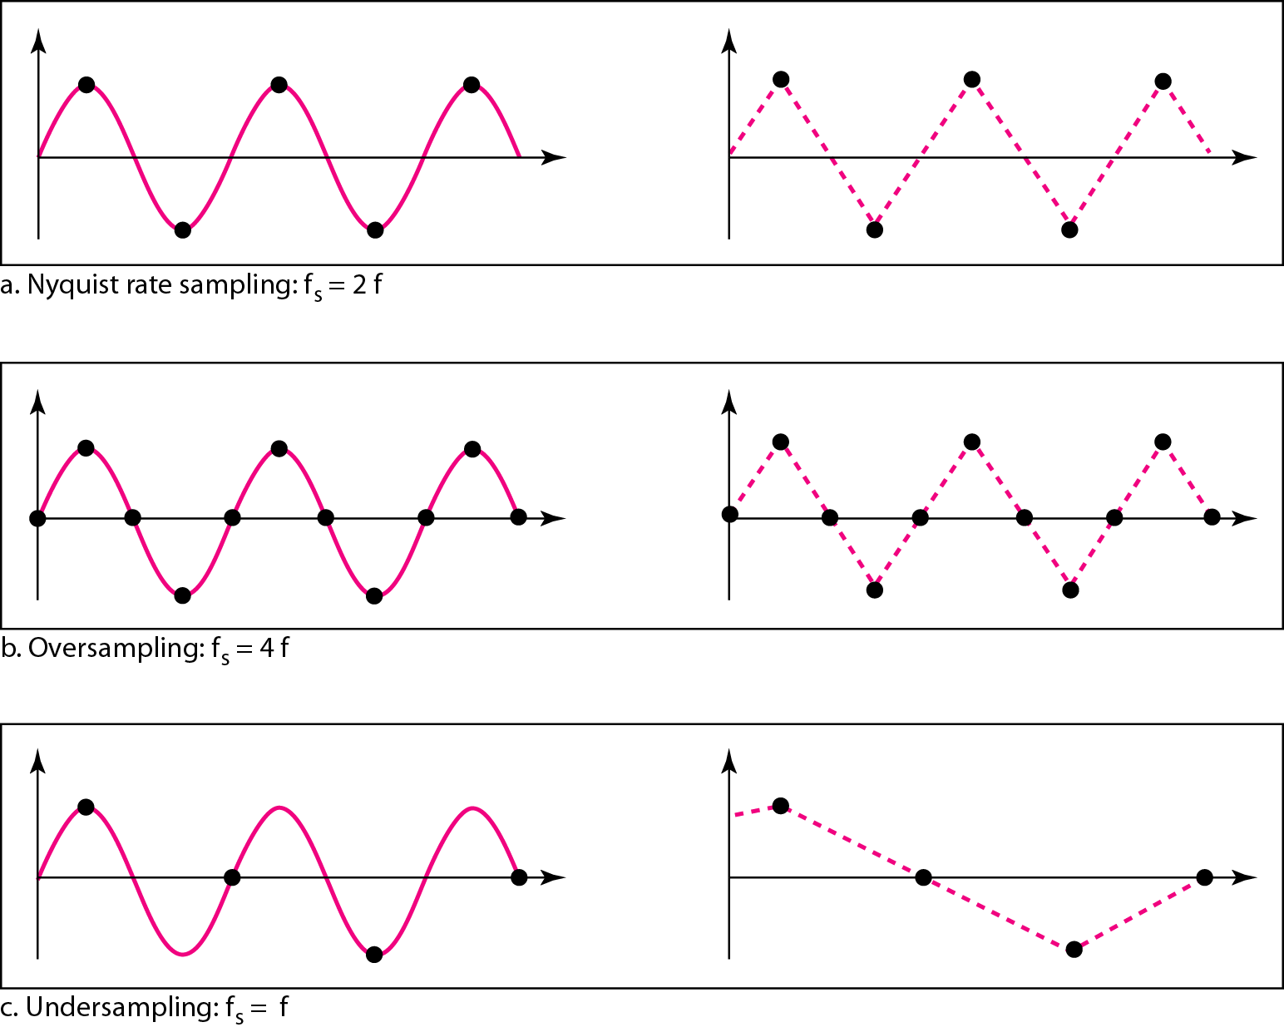

Recovery of a sampled sine wave for different sampling rates
22
Notes:
22

Slide 23
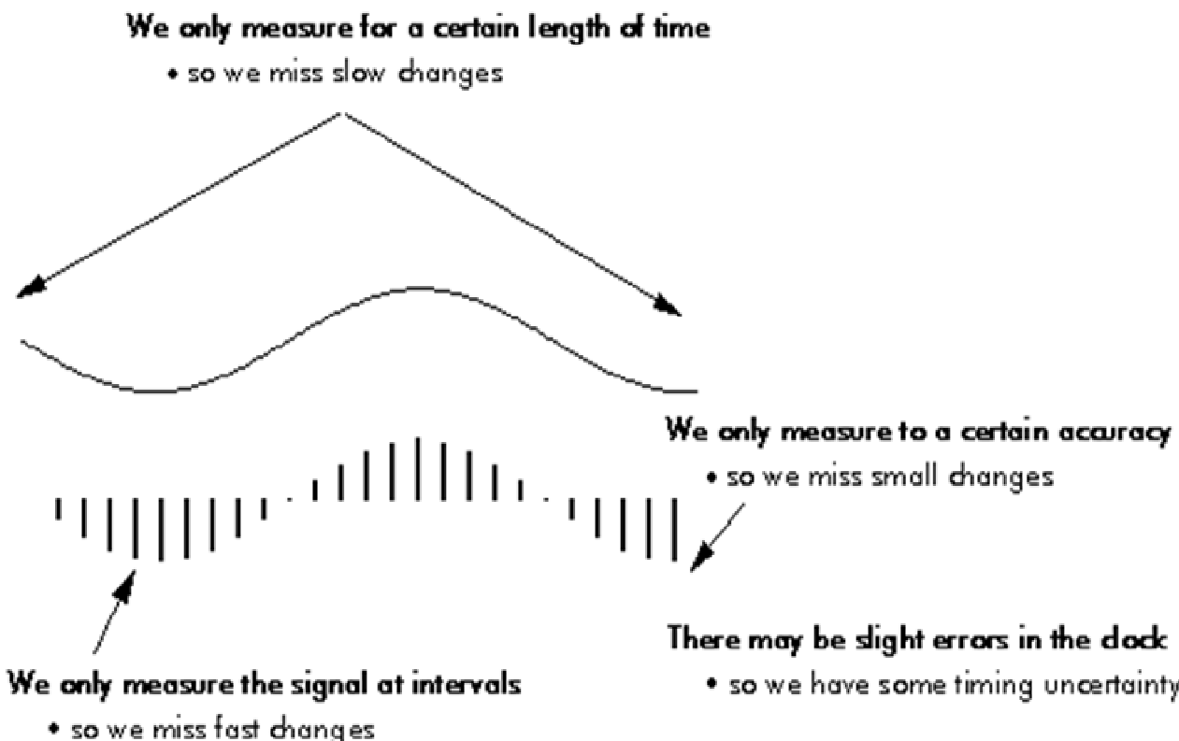
23

Slide 24
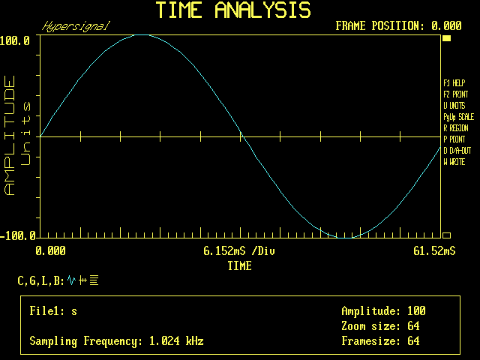
24

Slide 25
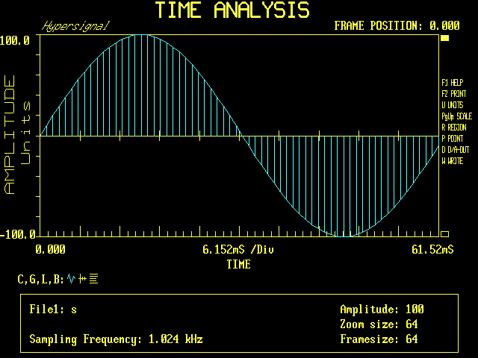
25

Slide 26
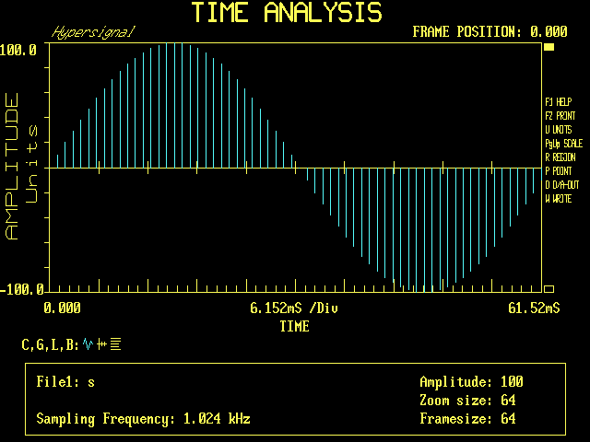
26

Slide 27




Sampling Theorem
F_{s} ≥ 2f_{m}
According to the Nyquist theorem, the sampling rate must be
at least 2 times the highest frequency contained in the signal.
27
Notes:
27

Slide 28
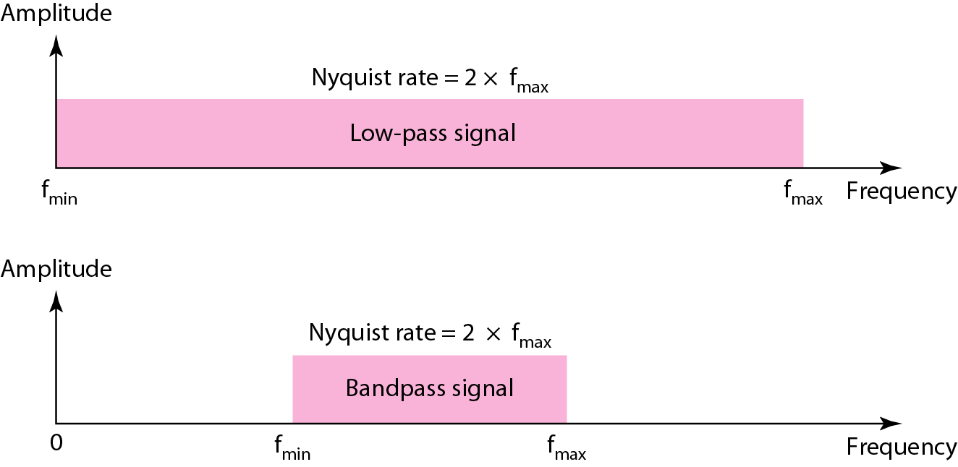









Nyquist sampling rate for low-pass and bandpass signals
28
Notes:
28

Slide 29


Quantization
Sampling results in a series of pulses of varying amplitude values ranging between two limits: a min and a max.
The amplitude values are infinite between the two limits.
We need to map the infinite amplitude values onto a finite set of known values.
This is achieved by dividing the distance between min and max into L zones, each of height Δ.
Δ = (max - min)/L
29

Slide 30


Quantization Levels
The midpoint of each zone is assigned a value from 0 to L-1 (resulting in L values)
Each sample falling in a zone is then approximated to the value of the midpoint.
30

Slide 31
Quantization Zones
Assume we have a voltage signal with amplitutes V_{min}=-20V and V_{max}=+20V.
We want to use L=8 quantization levels.
Zone width Δ = (20 - -20)/8 = 5
The 8 zones are: -20 to -15, -15 to -10, -10 to -5, -5 to 0, 0 to +5, +5 to +10, +10 to +15, +15 to +20
The midpoints are: -17.5, -12.5, -7.5, -2.5, 2.5, 7.5, 12.5, 17.5
31

Slide 32
Assigning Codes to Zones
Each zone is then assigned a binary code.
The number of bits required to encode the zones, or the number of bits per sample as it is commonly referred to, is obtained as follows:
n_{b} = log₂ L
Given our example, n_{b} = 3
The 8 zone (or level) codes are therefore: 000, 001, 010, 011, 100, 101, 110, and 111
Assigning codes to zones:
000 will refer to zone -20 to -15
001 to zone -15 to -10, etc.
32

Slide 33
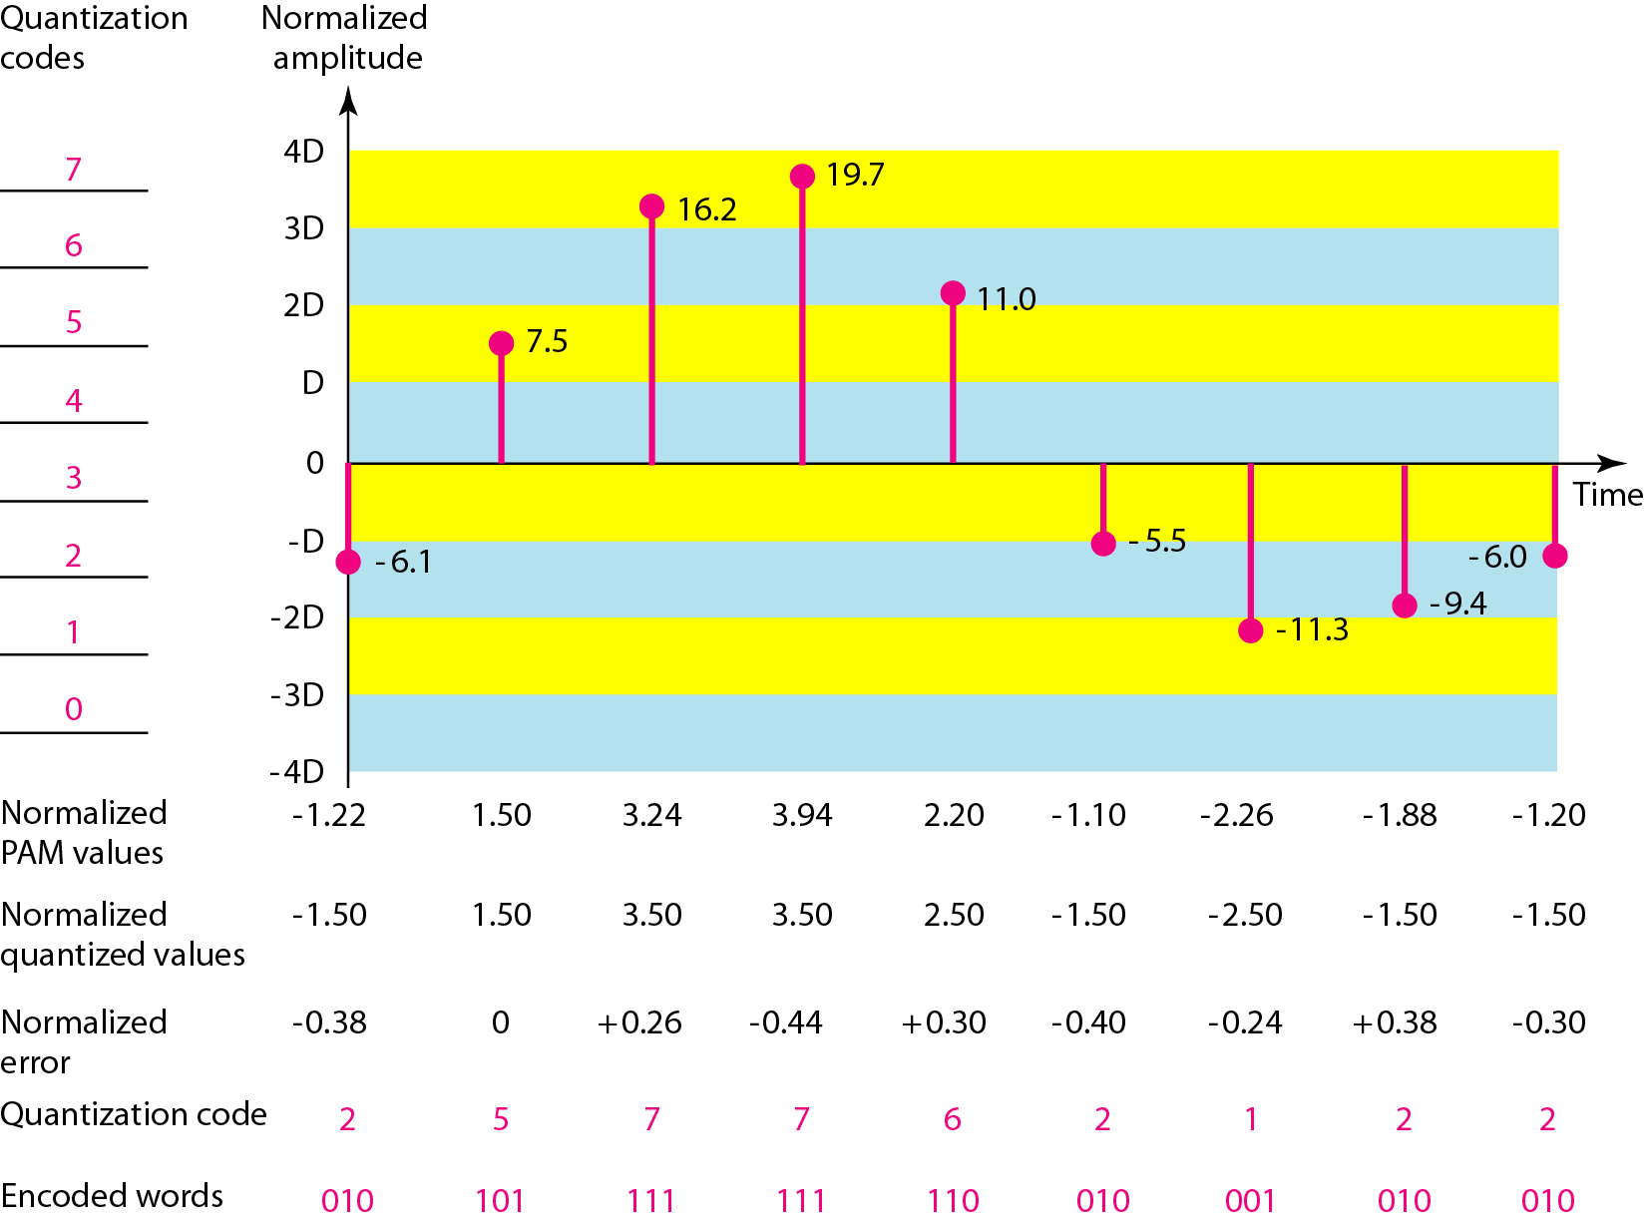
Quantization and encoding of a sampled signal
33
Notes:
33

Slide 34
Quantization Error
When a signal is quantized, we introduce an error
the coded signal is an approximation of the actual amplitude value.
The difference between actual and coded value (midpoint) is referred to as the quantization error.
The more zones, the smaller Δ
which results in smaller errors.
BUT, the more zones the more bits required to encode the samples
higher bit rate
34

Slide 35
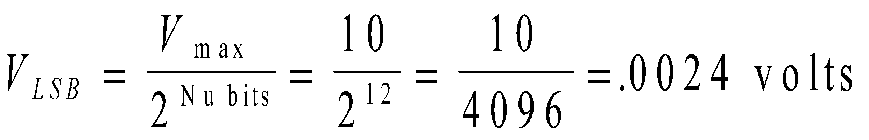
Analog-to-digital Conversion
Example An 12-bit analog-to-digital converter (ADC) advertises an accuracy of ± the least significant bit (LSB). If the input range of the ADC is 0 to 10 volts, what is the accuracy of the ADC in analog volts?
Solution:
If the input range is 10 volts then the analog voltage represented by the LSB would be:
Hence the accuracy would be ± 0.0024 volts.
35

Slide 36
Steps for digitization/reconstruction of a signal
Band limiting (LPF)
Sampling / Holding
Quantization
Coding
These are basic steps for A/D conversion
D/A converter
Sampling / Holding
Image rejection
These are basic steps for reconstructing a sampled digital signal
36

Slide 37
Digital data: end product of A/D conversion and related concepts
Bit: least digital information, binary 1 or 0
Nibble: 4 bits
Byte: 8 bits, 2 nibbles
Word: 16 bits, 2 bytes, 4 nibbles
Some jargon:
integer, signed integer, long integer, 2s complement, hexadecimal, octal, floating point, etc.
37

Slide 38
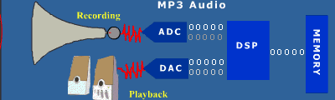
38

Slide 39
Example
Hertz = clock cycles per second (frequency)
1MHz = 1,000,000Hz
Processor speeds are measured in MHz or GHz.
Byte = a unit of storage
1KB = 2¹⁰ = 1024 Bytes
1MB = 2²⁰ = 1,048,576 Bytes
Main memory (RAM) is measured in MB
Disk storage is measured in GB for small systems, TB for large systems.
39
39

Slide 40
Number of Bits Required
Given M elements to be represented by a binary code, the minimum number of bits, n, needed, satisfies the following relationships:
2^{n} > M > 2^{(n – 1)}
n =⎡log₂ M⎤ where ⎡x⎤ , called the ceiling function, is the integer greater than or equal to x.
Example: How many bits are required to represent decimal digits with a binary code?
4 bits are required (n =⎡log₂ 9⎤ = 4)
40
Notes:
Copyright 2000 N. AYDIN. All rights reserved.
40
M = 10
Therefore n = 4 since:
2⁴ =16 is ≥ 10 > 2³ = 8
and the ceiling function for log₂ 10 is 4.

Slide 41
Number of Elements Represented
Given n digits in radix r, there are r^{n} distinct elements that can be represented.
But, you can represent m elements, m < r^{n}
Examples:
You can represent 4 elements in radix r = 2 with n = 2 digits: (00, 01, 10, 11).
You can represent 4 elements in radix r = 2 with n = 4 digits: (0001, 0010, 0100, 1000).
41
Notes:
Copyright 2000 N. AYDIN. All rights reserved.
41

